Slide 1
Day 3

Slide 2
Objectives (Contd.)
Day–3 Coverage
Objects and Arrays
  Properties and Methods
  Browser Object Hierarchy
  Addressing Objects
  Creating Objects
  Objects and Variables
  External Objects
  Security Implications
  Arrays and Objects

Slide 3
Objectives (Contd.)
Day–3 Coverage (Continued)
Document Object Model
  Introduction to DOM
  The Navigator Object
  The Window Object
  Communicating between windows
  Working With Frames in the DOM
  The Document object
  The Location & History Object
  Image Object
  Link Object

Slide 4
Objectives (Contd.)
Day–3 Coverage (Continued)
Form Validation The Form Object Model
  Recap of Form Elements
  Form Tag Events
  Controlling Submission
  Forms as Navigation
  List Events
  Buttons
  Text Processing

Slide 5
Objectives (Contd.)
Day–3 Coverage (Continued)
Cookies
  Introduction to HTTP Cookies
  Formatting Cookies
  Persisting Cookies
  Cookie Security
  JavaScript & Cookies
  Reading / Writing Cookies
  Modifying and deleting Cookies

Slide 6
Introduction to Java Scripts
What is JavaScript???
  JavaScript is a scripting Language created by Netscape
What is a Scripting Language???
Scripting Language is a lightweight programming language.
Scripting Languages are not needed to be compiled.
The language is interpreted at runtime.
Notes:
JavaScript is a simple scripting language invented specifically for use in web browsers to make websites more dynamic. On its own, HTML is capable of outputting more-or-less static pages. Once you load them up your view doesn't change much until you click a link to go to a new page. Adding JavaScript to your code allows you to change how the document looks completely, from changing text, to changing colours, to changing the options available in a drop-down list (and much, much more!).

Slide 7
Introduction to JavaScript (Contd.)
  A JavaScript is usually directly embedded in an HTML page.
  External JavaScripts can be created which can be used by HTML pages.
  JavaScript adds interactivity to HTML pages.
  JavaScript's are integrated into the browsing environment.
Notes:
JavaScripts are integrated into the browsing environment, which means they can get information about the browser and HTML page, and modify this information, thus changing how things are presented on your screen. This access to information gives JavaScript great power to modify the browsing experience. They can also react to events, such as when the user clicks their mouse, or points to a certain page element. This is also a very powerful ability.
JavaScript is supported by Netscape 2+, Internet Explorer 3+, Opera 3+ and most of the other modern web browsers. Each new version of the main browsers has supported new generations of JavaScript commands, each more complex than the last.

Slide 8
Objects
&
Arrays

Slide 9
JavaScript Objects
JavaScript is not a true Object Oriented language as C++ or Java but rather an Object Based language.
Objects in JavaScript are software entities such as the browser window or an HTML document.

Slide 10
JavaScript Objects (contd.)
JavaScript supports the following constructs that you can use to create an object:
the new operator
the object initializer
the constructor

Slide 11
JavaScript Objects (contd.)
The syntax of new operator:
The syntax of object initializer
var objectName = new Object()
objectName = {property1:value1, property2:value2 , … , propertyN:valueN}
The syntax of constructor function
var objectName = new FunctionName()
Notes:
In case on Object Initializer, each property argument is an identifier. The property value can contain a Name, Number or a String literal.

Slide 12
JavaScript Objects (contd.)
If you use the constructor function to create your own JavaScript object, you must fist define the object type by creating a function.
Then you create an instance of the new object type with the new operator.
To create an object of Computer function
Example
function Computer(CPU,RAM,HD,OS)
{
this.CPU = CPU
this.RAM = RAM
this.HD = HD
this.OS = OS
}
var c1 = new Computer (“PentiumIV”, 256,40, ”WindowsXP”)

Slide 13
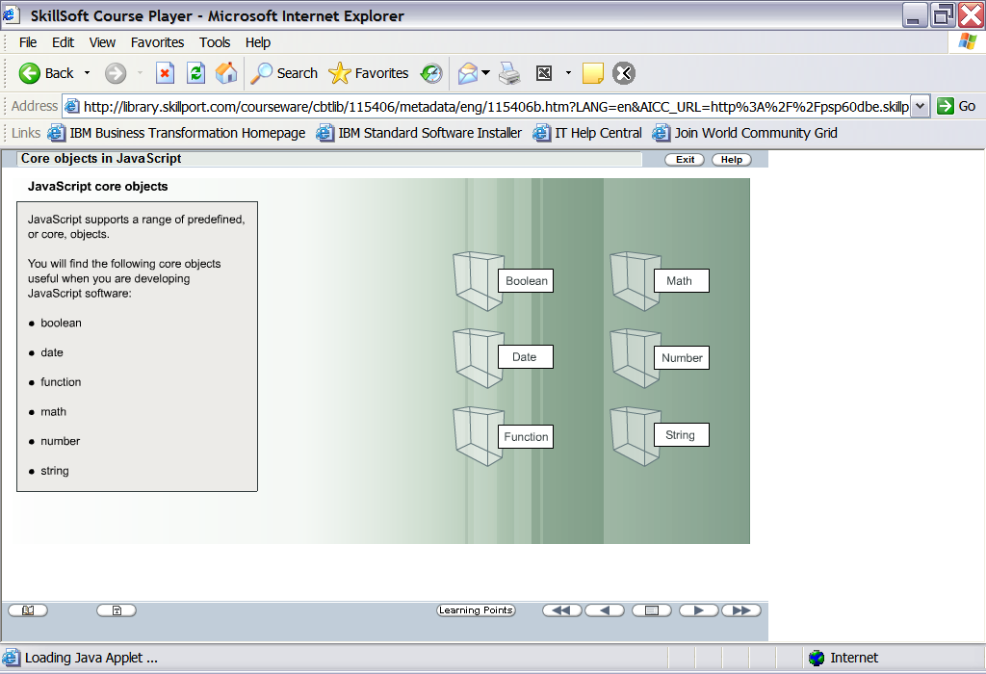
JavaScript Core Objects (contd.)
JavaScript supports a range of
predefined core objects:
Boolean
Math
1.
Boolean
2.
Date
Date
Number
3.
Function
4.
Math
5.
Number
Function
String
6.
String

Slide 14
JavaScript Core Objects (contd.)
JavaScript supports a range of
predefined core objects:
Boolean
Math
1.
Boolean
2.
Date
Date
Number
3.
Function
4.
Math
5.
Number
Function
String
6.
String

Slide 15
JavaScript Core Objects (contd.)
Boolean Object
  This object is used to convert a non boolean value to a boolean value.
  The Boolean Object is an Object Wrapper for a Boolean value
  Boolean object is defined with the new keyword
    var BooleanObj=new Boolean()
Notes:
If the Boolean object has no initial value or if it is 0, -0, null, "", false, undefined, or NaN, the object is set to false. Otherwise it is true (even with the string "false")!

Slide 16
JavaScript Core Objects (contd.)
All the following lines of code create Boolean objects with an initial value of false :
  var myBoolean=new Boolean()
  var myBoolean=new Boolean(0)
  var myBoolean=new Boolean(null)
  var myBoolean=new Boolean("")
  var myBoolean=new Boolean(false)
  var myBoolean=new Boolean(NaN)

Slide 17
JavaScript Core Objects (contd.)
All the following lines of code create Boolean objects with an initial value of true:
  var myBoolean=new Boolean(true)
  var myBoolean=new Boolean("true")
  var myBoolean=new Boolean("false")
  var myBoolean=new Boolean("Richard")

Slide 18
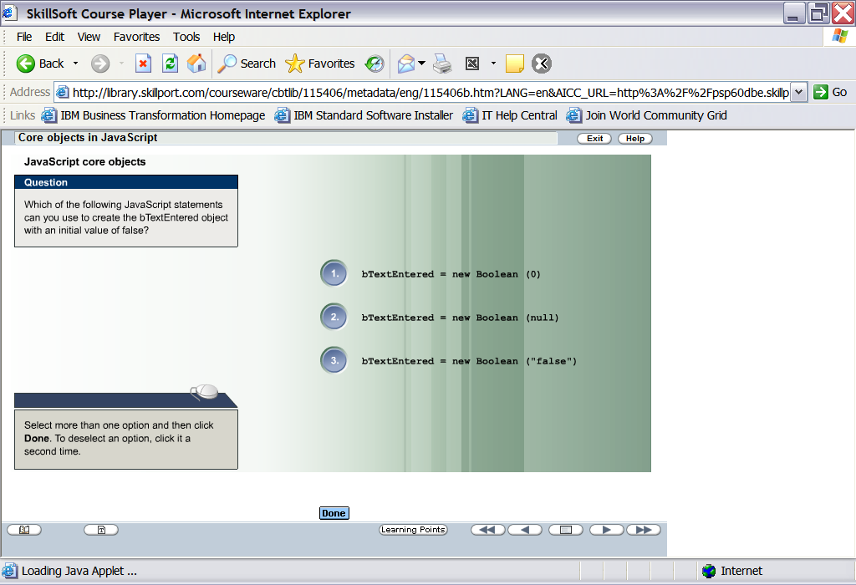
Test Your Understanding

Slide 19
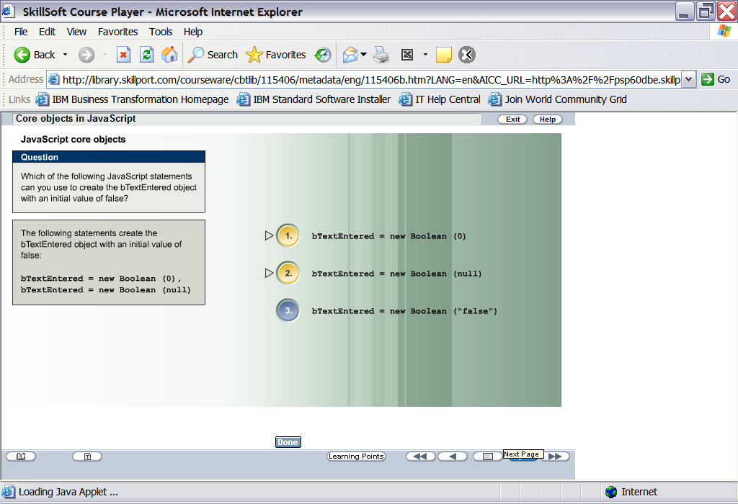
Test Your Understanding

Slide 20
JavaScript Core Objects (contd.)
JavaScript supports a range of
predefined core objects:
Boolean
Math
1.
Boolean
2.
Date
Date
Number
3.
Function
4.
Math
5.
Number
Function
String
6.
String

Slide 21
JavaScript Core Objects (contd.)
Date Object
  The Date object is used to work with dates and times.
  An instance of the Date object with the "new" keyword.
  An instance of Date object can be created as:
    var myDate=new Date()
    var myDate=new Date("Month dd, yyyy hh:mm:ss")
    var myDate=new Date("Month dd, yyyy")
    var myDate=new Date(yy,mm,dd,hh,mm,ss)
    var myDate=new Date(yy,mm,dd)
    var myDate= new Date(milliseconds)
Notes:
It stores the number of milliseconds elapsed from since January 1, 1970, 00:00:00.
Months are numbered as 0-11
Days are numbered as 0-6

Slide 22
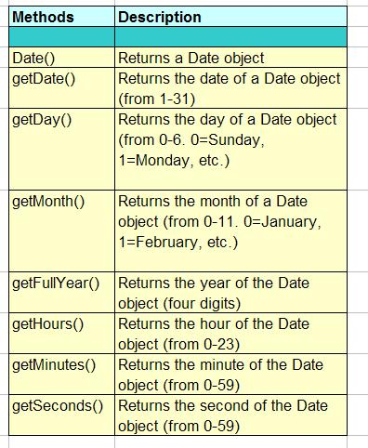
JavaScript Core Objects (contd.)
Commonly used methods of the Date Object

Slide 23
JavaScript Core Objects (contd.)
JavaScript supports a range of
predefined core objects:
Boolean
Math
1.
Boolean
2.
Date
Date
Number
3.
Function
4.
Math
5.
Number
Function
String
6.
String

Slide 24
JavaScript Core Objects (contd.)
To create an object of Computer function
Example
function Computer(CPU,RAM,HD,OS)
{
this.CPU = CPU
this.RAM = RAM
this.HD = HD
this.OS = OS
}
var c1 = new Computer (“PentiumIV”, 256,40, ”WindowsXP”)
In the previous slides we have discussed this, Here c1 is the function object.

Slide 25
JavaScript Core Objects (contd.)
JavaScript supports a range of
predefined core objects:
Boolean
Math
1.
Boolean
2.
Date
Date
Number
3.
Function
4.
Math
5.
Number
Function
String
6.
String

Slide 26
JavaScript Core Objects (contd.)
Math Object
  Math object allows to perform common mathematical functions.
  The Math object includes several Mathematical values and functions.
  The Math object need not be defined before using it.

Slide 27
JavaScript Core Objects (contd.)
Mathematical values provided by JavaScript
  Math.E
  Math.PI
  Math.SQRT2
  Math.SQRT1_2
  Math.LN2
  Math.LN10
  Math.LOG2E
  Math.LOG10E
Notes:
JavaScript provides eight mathematical values (constants) that can be accessed from the Math object. These are: E, PI, square root of 2, square root of 1/2, natural log of 2, natural log of 10, base-2 log of E, and base-10 log of E.

Slide 28
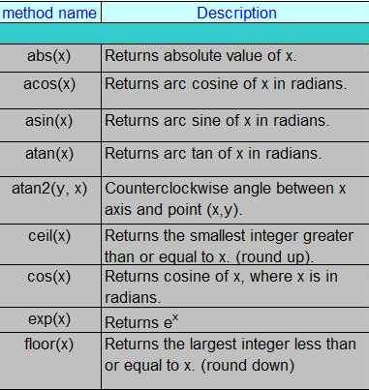
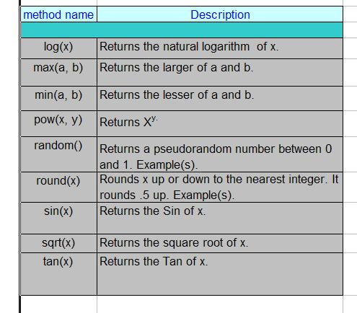
JavaScript Core Objects (contd.)
Methods of Math object
Notes:
If you intend to invoke Math multiple times in your script, a good statement to remember is "with." Using it you can omit the "Math." prefix for any subsequent Math properties/methods:
with (Math)
{ var x= sin(3.5)
var y=tan(5)
var result=max(x,y) }

Slide 29
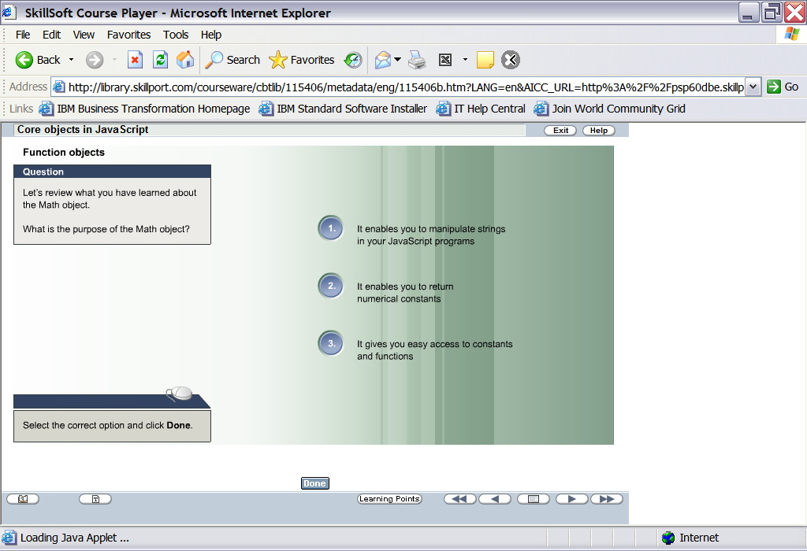
Test Your Understanding

Slide 30
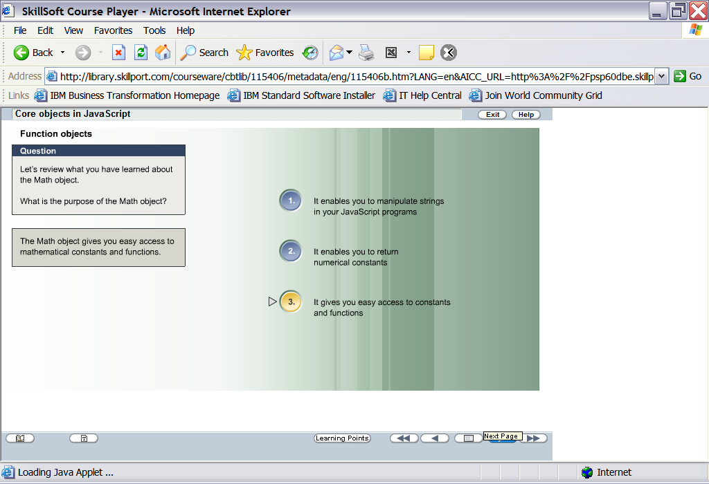
Test Your Understanding

Slide 31
JavaScript Core Objects (contd.)
JavaScript supports a range of
predefined core objects:
Boolean
Math
1.
Boolean
2.
Date
Date
Number
3.
Function
4.
Math
5.
Number
Function
String
6.
String

Slide 32
JavaScript Core Objects (contd.)
Points to be noted in regard to Number object:
The JavaScript Number object returns numerical constants.
You can’t change the value of the number object’s properties.
Number object properties are called static properties.

Slide 33
JavaScript Core Objects (contd.)
Properties of Number object:
MIN_VALUE
MAX_VALUE
NaN
NEGATIVE_INFINITY
POSITIVE_INFINITY
Example:
// Overflow trap
Car toohigh;
If(toohigh>=Number.MAX_VALUE)
{
take necessary steps to reduce the vale
}

Slide 34
JavaScript Core Objects (contd.)
JavaScript supports a range of
predefined core objects:
Boolean
Math
1.
Boolean
2.
Date
Date
Number
3.
Function
4.
Math
5.
Number
Function
String
6.
String

Slide 35
JavaScript Core Objects (contd.)
String object
  The String object is used to manipulate a stored piece of text.
  String objects must be created using the new keyword.
  JavaScript automatically converts the string primitive to a temporary String object
  A string literal can be embedded within a single or double quotation marks.
Notes:
Because Javascript automatically converts between string primitives and String objects, you can call any of the methods of the String object on a string primitive

Slide 36
JavaScript Core Objects (contd.)
String primitives and String objects give different results when evaluated as JavaScript.
Primitives are treated as source code, but String objects are treated as a character sequence object.
  s1 = “2 + 2” // creates a string primitive
  s2 = new String("2 + 2") // creates a String object
  eval(s1) // returns the number 4
  eval(s2) // returns the string “2 + 2”
  eval(s2.valueOf()); // returns the number 4

Slide 37
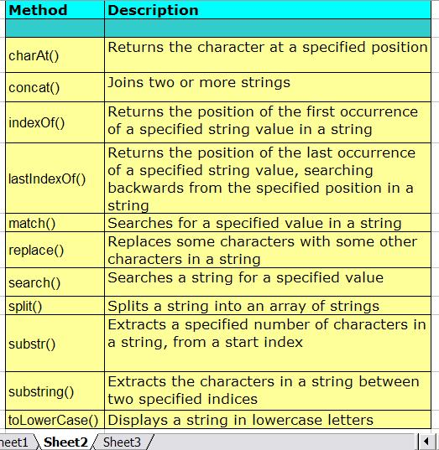
JavaScript Core Objects (contd.)
Common Methods of String Object

Slide 38
Defining Arrays
An Array object is used to store a set of values in a single variable name.
An Array object is created with the new keyword.
An array can be created as:
  var MyArray=new Array()
An array can also be created by specifying the array size.
  var MyArray=new Array(3)

Slide 39
Arrays (contd.)
Data can be entered into an array as:
  var MyArray=new Array()
  MyArray[0]=“Paul”
  MyArray[1]=“Sam”
  MyArray[2]=“Niel”
Data can also be entered into an array as:
  var MyArray=new Array(“Paul”,”Sam”, “Niel”)
Notes:
If you specify numbers or true/false values inside the array then the type of variables will be numeric or Boolean instead of string.

Slide 40
Arrays (contd.)
Accessing Arrays
  You can refer to a particular element in an array by referring to the name of the array and the index number.
  The index number starts at 0 .
  var MyArray=new Array()
  Myarray [0]
The starting index
Notes:
To modify/insert a value in an existing array, just add a new value to the array with a specified index number:

Slide 41
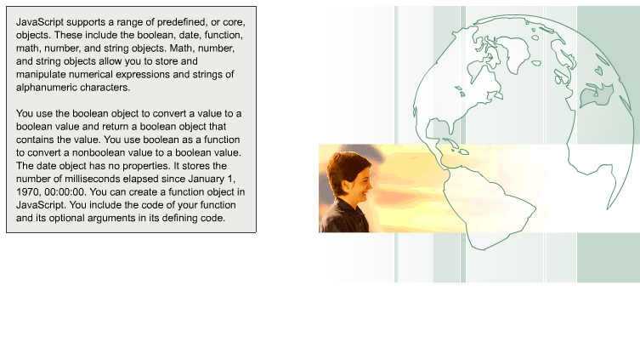
Summary

Slide 42
Document Object
Model

Slide 43
Document Object Model
The DOM is a programming API for documents.
It is based on an object structure that closely resembles the structure of the documents it models.
For instance, consider this table, taken from an HTML document:
<TABLE>
<TBODY>
<TR> <TD>Shady Grove</TD> <TD>Aeolian</TD> </TR>
<TR> <TD>Over the River, Charlie</TD> <TD>Dorian</TD> </TR>
</TBODY>
</TABLE>
Notes:
The Document Object Model (DOM) is an application programming interface (API) for valid HTML and well-formed XML documents. It defines the logical structure of documents and the way a document is accessed and manipulated
In the DOM, documents have a logical structure which is very much like a tree; to be more precise, which is like a "forest" or "grove", which can contain more than one tree. Each document contains zero or one doctype nodes, one root element node, and zero or more comments or processing instructions; the root element serves as the root of the element tree for the document. However, the DOM does not specify that documents must be implemented as a tree or a grove, nor does it specify how the relationships among objects be implemented. The DOM is a logical model that may be implemented in any convenient manner. In this specification, we use the term structure model to describe the tree-like representation of a document.

Slide 44
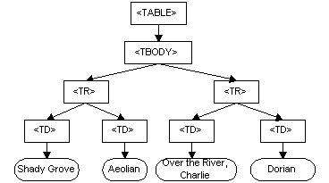
Document Object Model (contd.)
Graphical representation of the DOM of the example table
Notes:
The Document Object Model (DOM) is an application programming interface (API) for valid HTML and well-formed XML documents. It defines the logical structure of documents and the way a document is accessed and manipulated
In the DOM, documents have a logical structure which is very much like a tree; to be more precise, which is like a "forest" or "grove", which can contain more than one tree. Each document contains zero or one doctype nodes, one root element node, and zero or more comments or processing instructions; the root element serves as the root of the element tree for the document. However, the DOM does not specify that documents must be implemented as a tree or a grove, nor does it specify how the relationships among objects be implemented. The DOM is a logical model that may be implemented in any convenient manner. In this specification, we use the term structure model to describe the tree-like representation of a document.

Slide 45
Document Object Model (contd.)
With JavaScript you can restructure an entire HTML document. You can add, remove, change, or reorder items on a page.
To change anything on a page, JavaScript needs access to all elements in the HTML document. This access, along with methods and properties to add, move, change, or remove HTML elements, is given through the Document Object Model (DOM).
In 1998, W3C published the Level 1 DOM specification. This specification allowed access to and manipulation of every single element in an HTML page.
All browsers have implemented this recommendation, and therefore, incompatibility problems in the DOM have almost disappeared.

Slide 46

Document Object Model (contd.)
Document Tree
Notes:
All the nodes above have relationships to each other.
Every node except for the document node has a parent node. E.g. the parent node of the <head> and <body> nodes are the <html> node, and the parent node of the "Hello world!" text node is the <p> node.
Most element nodes have child nodes. E.g. the <head> node has one child node: the <title> node. The <title> node also has one child node: the text node "DOM Tutorial".
Nodes are siblings when they share a parent. E.g. the <h1> and <p> nodes are siblings, because their parent is the <body> node.
Nodes can also have descendants. Descendants are all the nodes that are children of a node, or children of those children, and so on. E.g. all text nodes are descendants of the <html> node, while the first text node are descendant of the <head> node.
Nodes can also have ancestors. Ancestors are nodes that are parents of a node, or parents of this parent, and so on. E.g. all text nodes have the <html> node as an ancestor.

Slide 47
How to access the nodes in an HTML
You can find the element you want to manipulate in several ways:
  By using the getElementById() and getElementsByTagName() methods
  By using the parentNode, firstChild, and lastChild properties of an element node

Slide 48
Navigator Object
Navigator object is the object representation of the client internet browser or web navigator program that is being used.
This is a top level object to all others object in DOM hierarchy.

Slide 49
Navigator Object Properties
appCodeName – The name of the browser’s code such as Internet Explorer
appName – The name of the browser.
appVersion – The version of the browser.
plugins – An array of plug-ins supported by the browser and installed on the browser.
cpuClass – The type of CPU which may be “x86”.
cookieEnabled – A boolean value of true or false depending on whether cookies are enabled in the browser.

Slide 50
Navigator Object Methods
javaEnabled() – Returns a boolean telling if the browser has JavaScript enabled.

Slide 51
Window Object
The Window object is the top level object in the JavaScript hierarchy.
The Window object represents a browser window.
A Window object is created automatically with every instance of a <body> or <frameset> tag.

Slide 52
Window Object Collections
Frames[] – Returns all named frames in the window.

Slide 53
Window Object Properties
name – sets of return the name of the window.
status – sets or returns the name of the window.
length – sets or returns the number of frames in the window.
self – returns a reference to the current window.
statusbar - sets whether or not the browser’s statusbar should be visible.
toolbar - sets whether or not the browser’s toolbar should be visible.
closed – Returns all named frames in the window
document
history

Slide 54
Window Object Methods
open() – Opens a new browser window.
createPopup() – Creates a popup window.
setInterval(code,millisec[,lang]) – Evaluates an expression at specified intervals.
clearInterval(id_of_setInterval) – cancels a timeout that is set with the setInterval() method.
setTimeout(code,millisec[,lang]) – Evaluates an expression after a specified number of milliseconds.
clearTimeout(id_of_setTimeout) – cancels a timeout that is set with the setTimeout() method.
focus() – sets the focus to the current window.
blur() – removes focus from the current window.
close() – closes the current window.
Notes:
setTimeout(code,millisec[,lang]) – where, code refers to a pointer to a function or the code to be executed, millisec refers to time in milliseconds, lang refers to Language in use (JavaScript,VBScript).
setInterval(code,millisec[,"lang"]) - where, code refers to a pointer to a function or the code to be executed, millisec refers to time in milliseconds, lang refers to Language in use (JavaScript,VBScript).
clearInterval(id_of_setinterval) - The ID value returned by setInterval() is used as the parameter for the clearInterval() method. It is a int value.
clearTimeout(id_of_setTimeout) – id of the setTimeout method(). It is a int value.
moveTo(x,y) – Moves a window to the specified position. x refers to the current x coordinate, y refers to the current y coordinate.
moveBy(x,y) – Moves a window relative to its current position. x refers to the current x coordinate, y refers to the current y coordinate.

Slide 55
Frame Object
Frame object represents an HTML frame.
For each instance of a <frame> tag in an HTML document, a Frame object is created.
Notes:
imageObject.align=left|right|top|middle|bottom
Go(number/URL) – number specifies the position of the page in the list.
Src – Sets or returns the URL of an image. The new image inherits the height & width attributes of the original image.

Slide 56
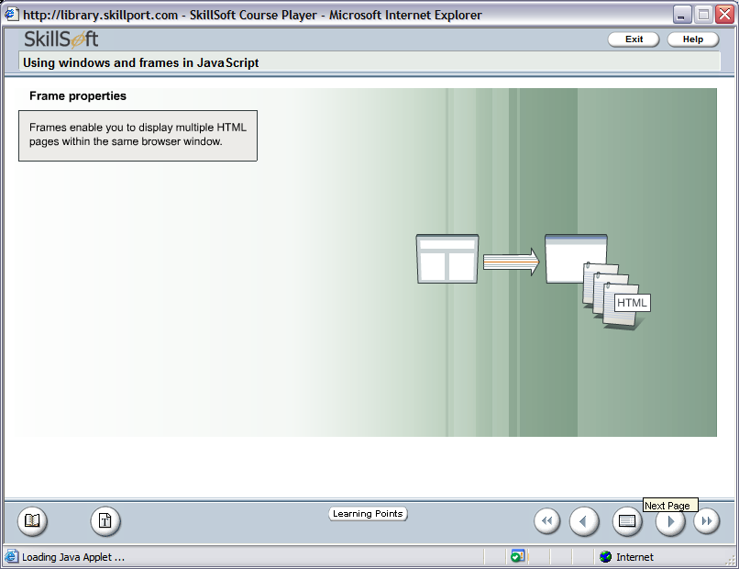
Frame Object (contd.)
In
Document Object Model
Frames are instances of Window object

Slide 57
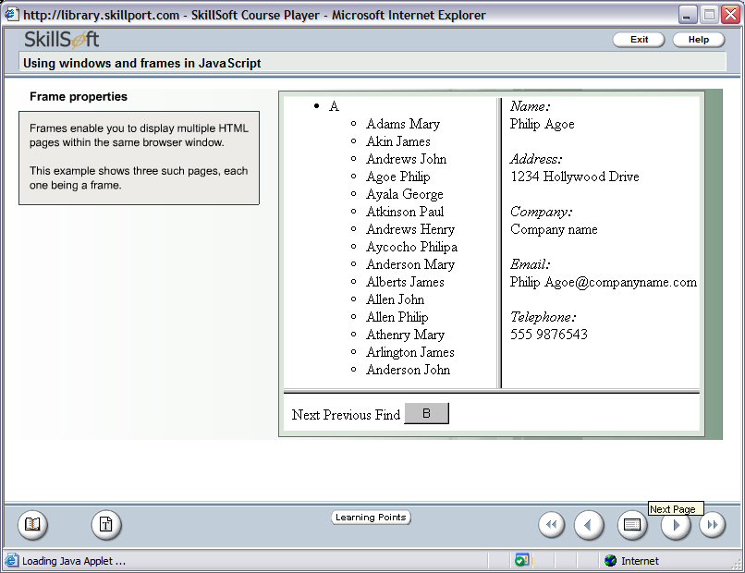
Frame Object (contd.)

Slide 58
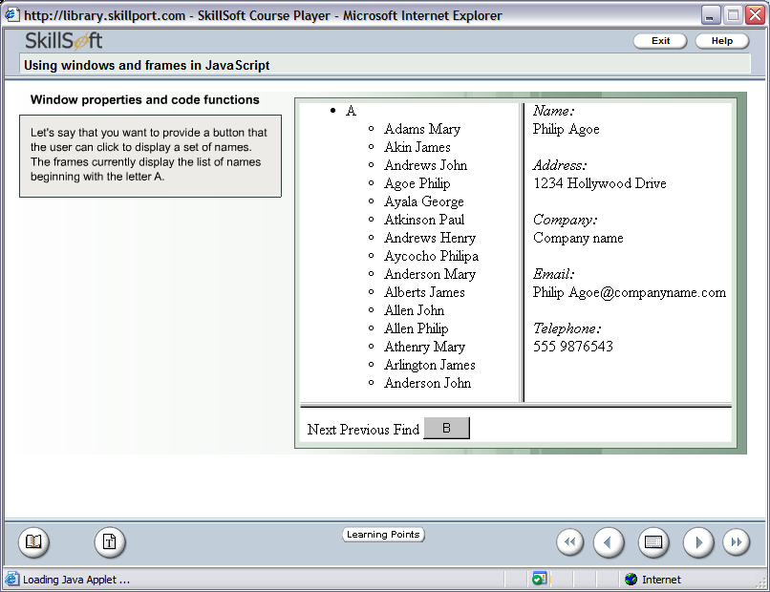
Frame Object (contd.)

Slide 59
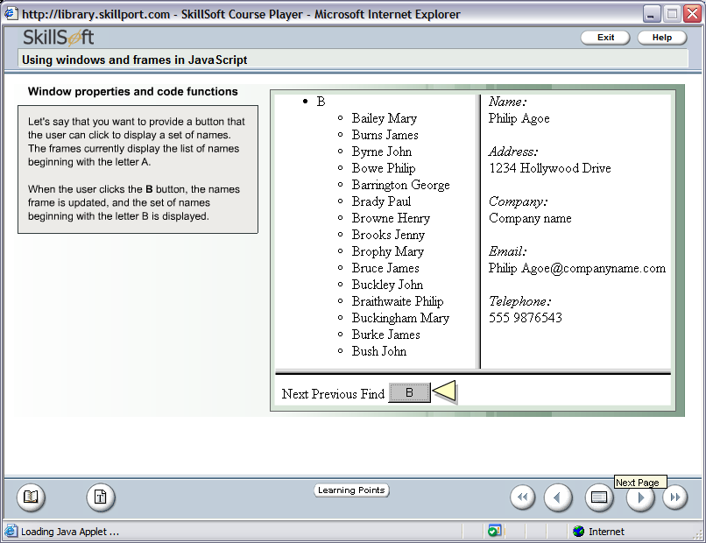
Frame Object (contd.)

Slide 60
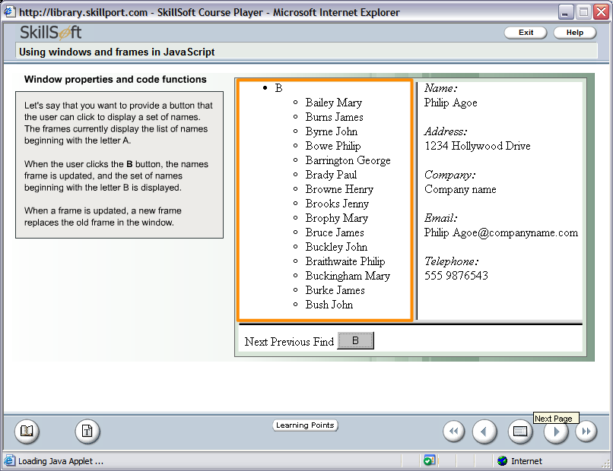
Frame Object (contd.)

Slide 61
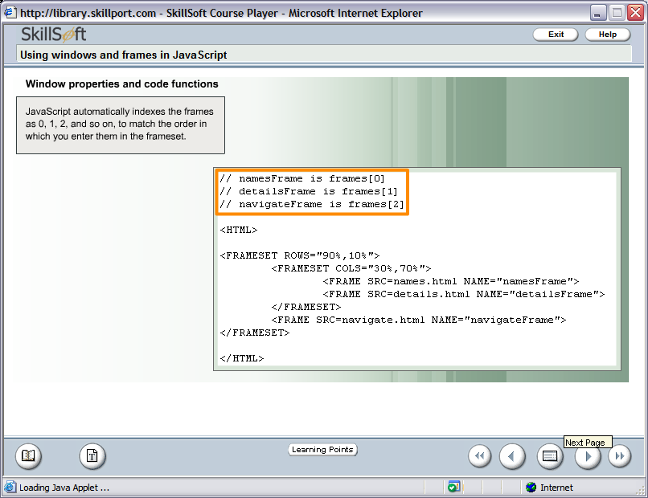
Frame Object (contd.)

Slide 62
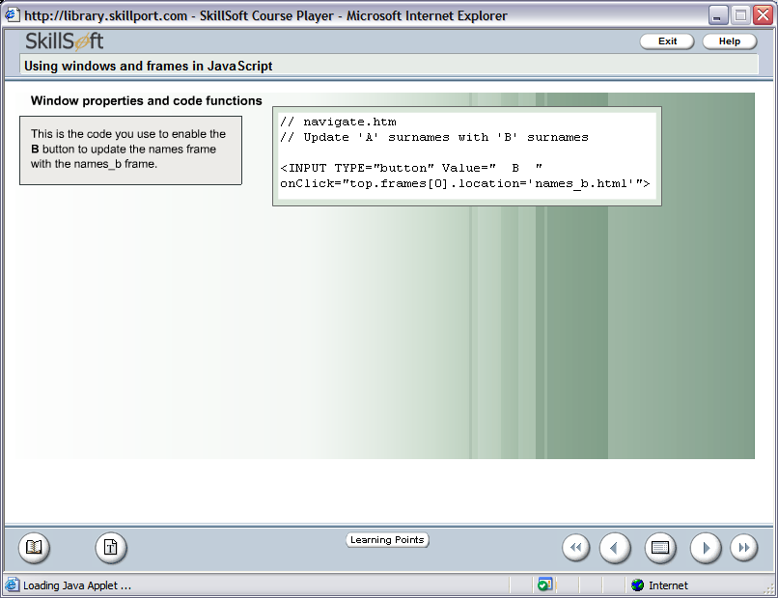
Frame Object (contd.)

Slide 63
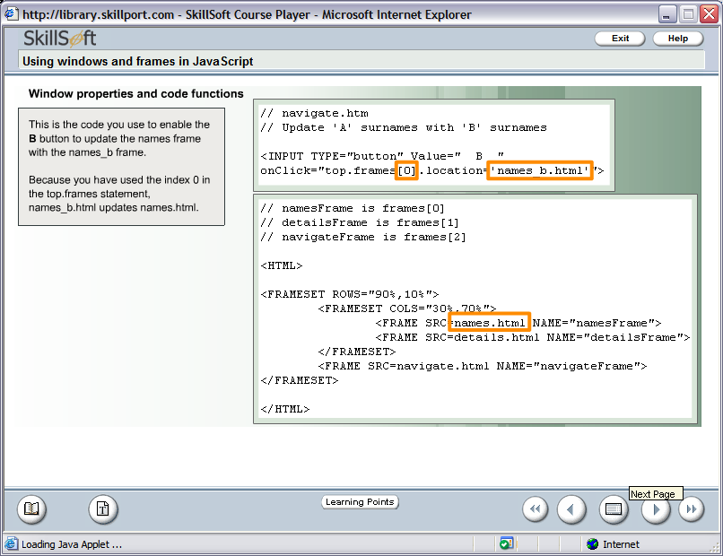
Frame Object (contd.)

Slide 64
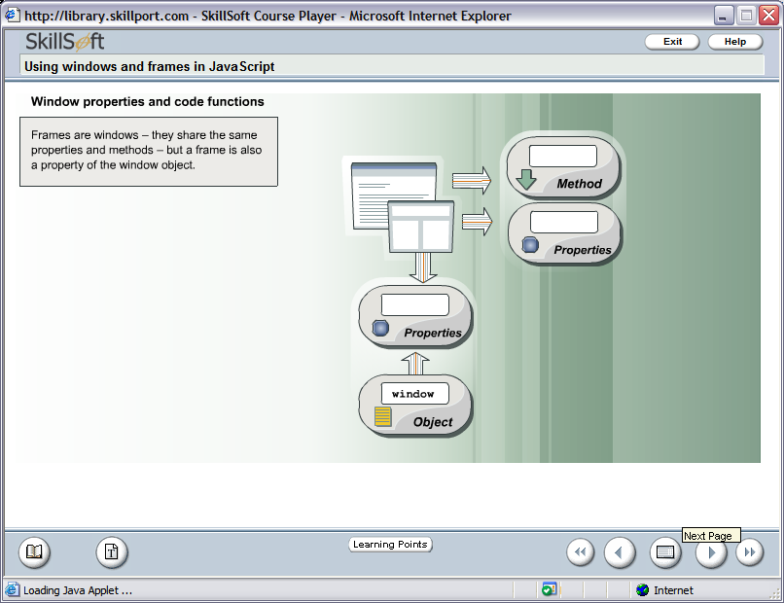
Frame Object (contd.)

Slide 65
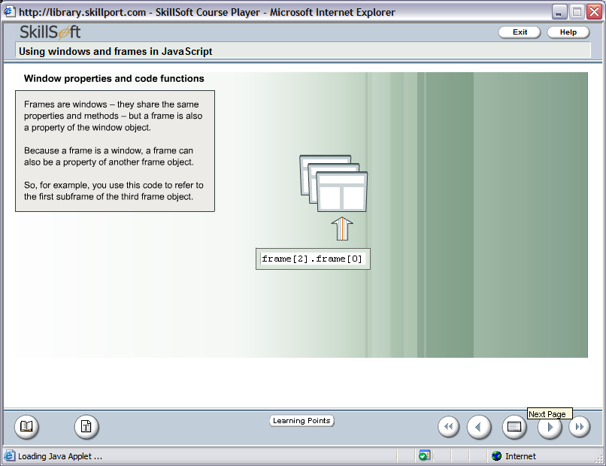
Frame Object (contd.)

Slide 66
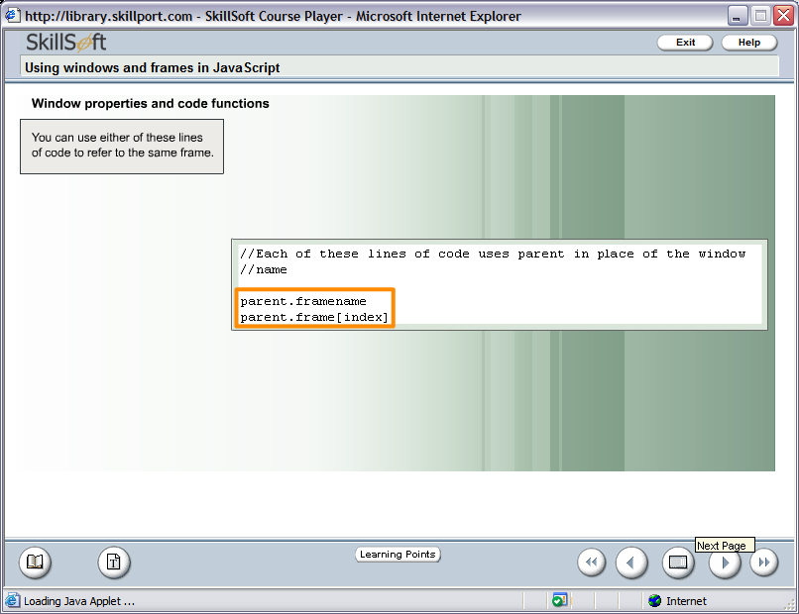
Frame Object (contd.)

Slide 67
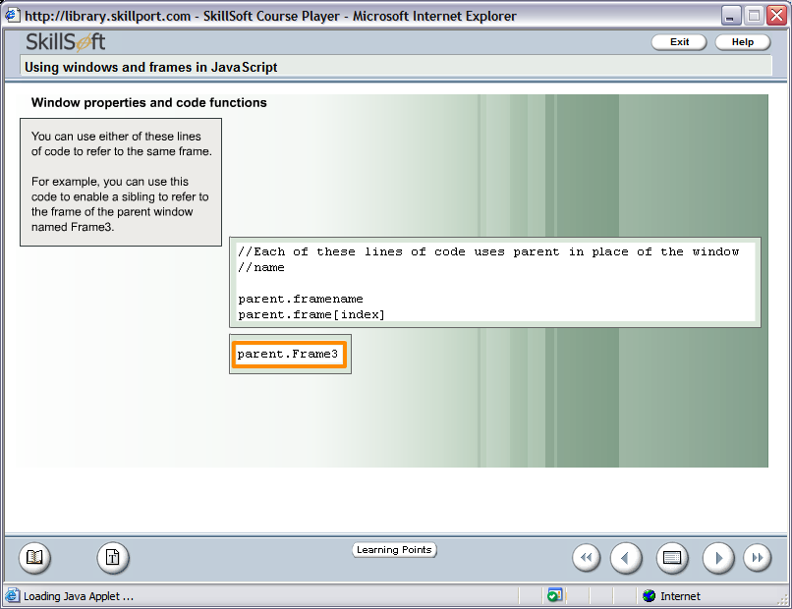
Frame Object (contd.)

Slide 68
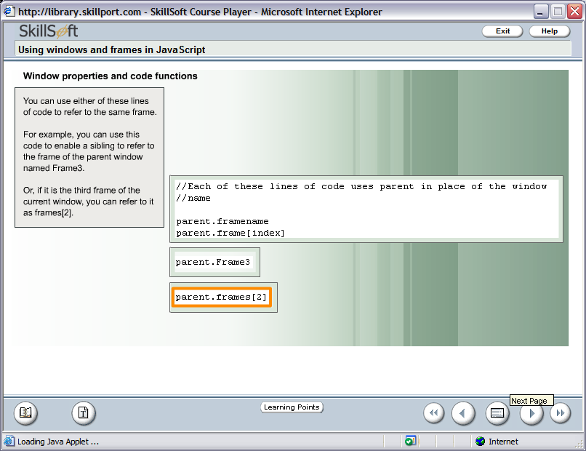
Frame Object (contd.)

Slide 69
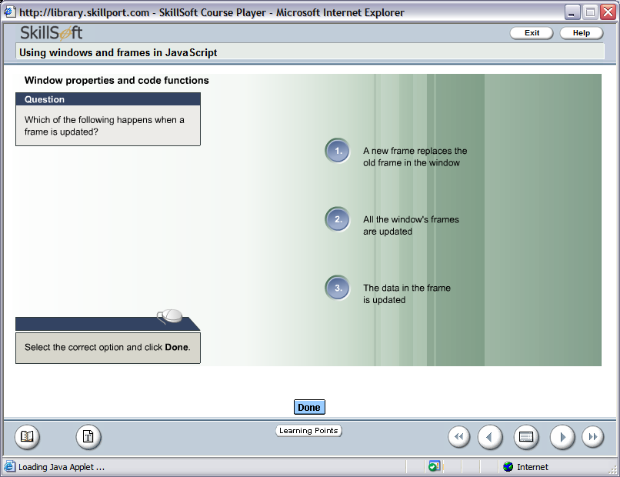

Test Your Understanding

Slide 70
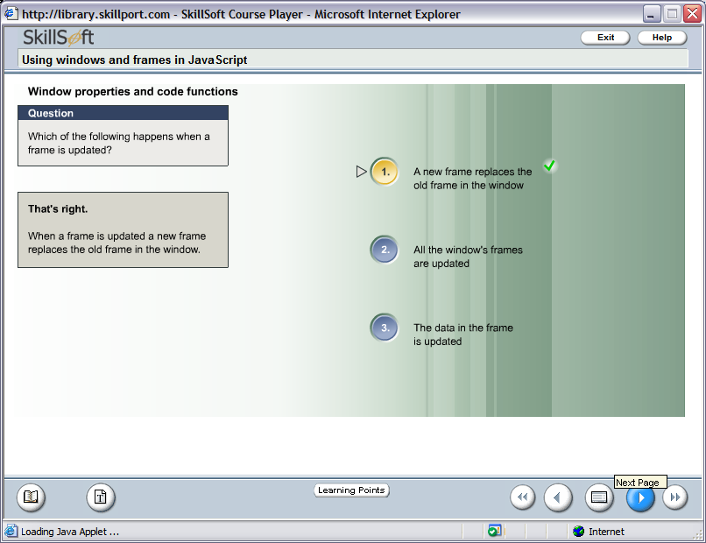
Test Your Understanding

Slide 71
Document Object
The document object represents the entire HTML document and can be used to access all elements in a page.
The document object is part of the window object and is accessed through the window.document property or simply document.
Notes:
setTimeout(code,millisec[,lang]) – where, code refers to a pointer to a function or the code to be executed, millisec refers to time in milliseconds, lang refers to Language in use (JavaScript,VBScript).
setInterval(code,millisec[,"lang"]) - where, code refers to a pointer to a function or the code to be executed, millisec refers to time in milliseconds, lang refers to Language in use (JavaScript,VBScript).
clearInterval(id_of_setinterval) - The ID value returned by setInterval() is used as the parameter for the clearInterval() method. It is a int value.
clearTimeout(id_of_setTimeout) – id of the setTimeout method(). It is a int value.
moveTo(x,y) – Moves a window to the specified position. x refers to the current x coordinate, y refers to the current y coordinate.
moveBy(x,y) – Moves a window relative to its current position. x refers to the current x coordinate, y refers to the current y coordinate.

Slide 72
Document Object Collections
anchors[] - Returns a reference to all Anchor objects in the document.
forms[] - Returns a reference to all Form objects in the document.
images[] - Returns a reference to all Image objects in the document.
links[] - Returns a reference to all Area and Link objects in the document.

Slide 73
Document Object Properties
Body – gives direct access to the <body> element.
Cookie – Sets or returns all cookies associated with the current document.
lastModified – Returns the date and time a document was last modified.
Title – Returns the title of the current document.
URL – Returns the URL of the current document.

Slide 74
Document Object Methods
write() - Writes HTML expressions or JavaScript code to a document
writeln() – Similar to write(), with the addition of writing a new line character after each expression.
open() - Opens a stream to collect the output from any document.write() or document.writeln() methods.
close() - Closes an output stream opened with the document.open() method, and displays the collected data
getElementByID() – Returns a reference to the first object with the specified id.
getElementsByName() – Returns a collection of objects with the specified name.
getElementsByTagName() – Return a collection of objects with the specified tag name.

Slide 75
Location Object
Location object is an JavaScript object it is not an DOM object.
The Location object is automatically created by the JavaScript runtime engine and contains information about the current URL.
The Location object is part of the Window object and is accessed through the window.location property.

Slide 76
Location Object Properties
href – It contains the complete URL of the currently displayed document.
protocol – specifies the protocol to be used with the document.
Example
window.location.href = http://www.ibm.com
It sets the URL address of the current document.

Slide 77
Location Object Methods
Assign (url) – It loads a new document.
Reload() – the current document.
Replace() – Replaces the current document with a new one.

Slide 78
Location Object Example
<html>
<body>
<script>
switch (window.location.protocol)
{
case "http:":
document.write("From Web<BR>\n")
break
case "file:":
document.write("From Local computer<BR>\n")
break
default:
document.write("Unknown Source<BR>\n")
break
}
</script>
</body>
</html>

Slide 79
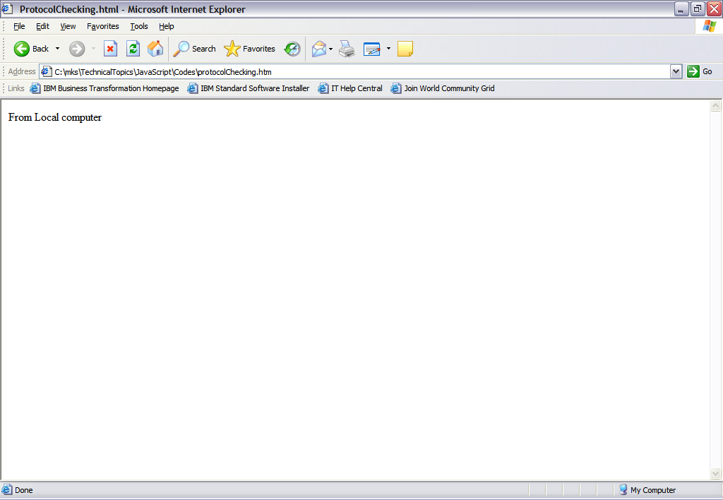
Output:
If Accessed from the Local File System

Slide 80
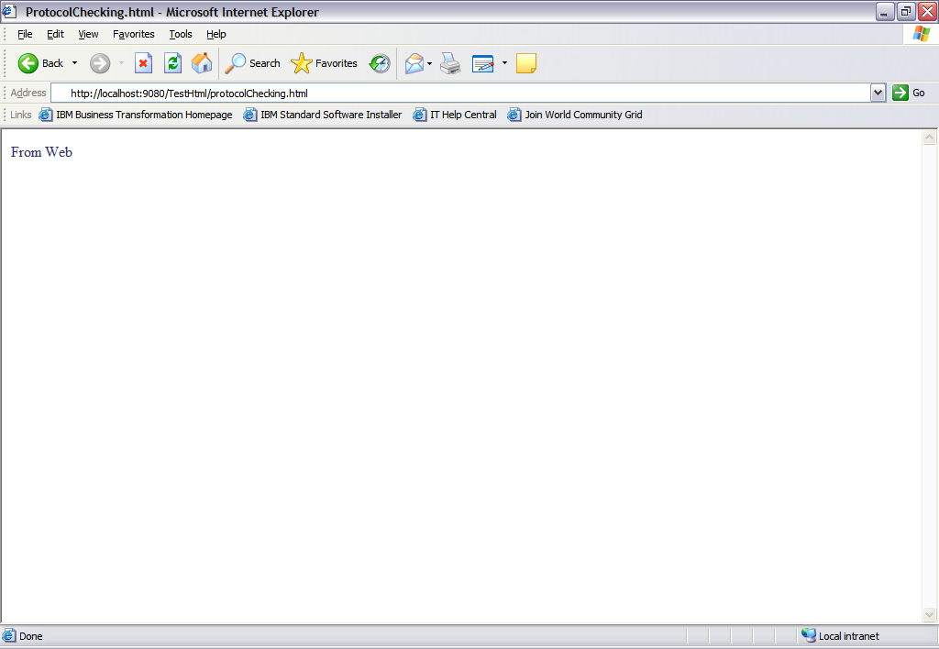
Output:
If the page is delivered by a Web Server.

Slide 81
History Object
Windows and Frames maintain an array that enables the user to navigate back and forth between URLs previously viewed in the current browser session. This array is called the History object.
History object is a JavaScript object.
The History object is automatically created by the JavaScript runtime engine and consists of and array of URLs.
History object is a window property.
It is a part of window object & accessed through window.history property.

Slide 82
History Object (contd.)
The two most useful methods of history object are:
  back() – enables the user to see the previous URL in the history
  array.
  forward() - enables the user to see the next URL in the history
  array.
Notes:
go(number|URL) – Loads a specific page in the history list.
Length is a property that returns the number of elements in the history list.

Slide 83
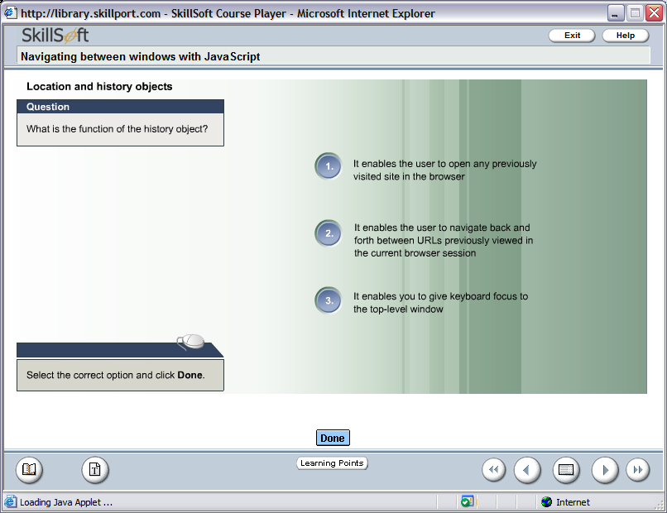
Test Your Understanding

Slide 84
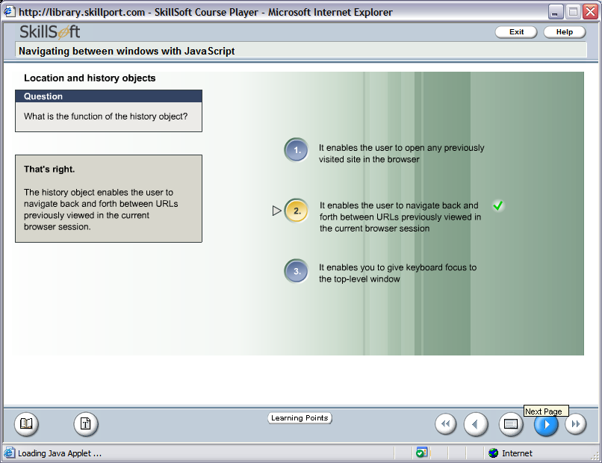
Test Your Understanding

Slide 85
Image Object
Image object represents an embedded image.
For each instance of an <img> tag in an HTML document, an Image object is created.
Notes:
Go(number/URL) – number specifies the position of the page in the list.

Slide 86
Image Object Properties
Name – Sets or returns the name of an image.
align – Sets or returns how to align an image according to the surrounding text.
Alt – Sets or returns an alternate text to be displayed, if a browser cannot show an image.
Border – Sets or returns the border around an image.
Height & width – Sets or returns the height & width of an image.
Src – Sets or returns the URL of an image.
useMap - sets or returns the value of the usemap attribute of an image.
Notes:
imageObject.align=left|right|top|middle|bottom
Go(number/URL) – number specifies the position of the page in the list.
Src – Sets or returns the URL of an image. The new image inherits the height & width attributes of the original image.

Slide 87
Link Object
The Link object represents an HTML <link> element.
The <link> element defines the relationship between two linked documents.
The <link> element is defined in the head section of an HTML document.
Notes:
imageObject.align=left|right|top|middle|bottom
Go(number/URL) – number specifies the position of the page in the list.
Src – Sets or returns the URL of an image. The new image inherits the height & width attributes of the original image.

Slide 88
Link Object Properties
Href – Sets or returns the URL of the linked resources.
Id – Sets or returns the id of a <link> element.
Name – Sets or returns the name of a <link> element.
Type – Sets or returns the MIME type of the target URL (like “text/css”,text/javascript”,”image/gif”,etc.).
Notes:
imageObject.align=left|right|top|middle|bottom
Go(number/URL) – number specifies the position of the page in the list.
Src – Sets or returns the URL of an image. The new image inherits the height & width attributes of the original image.

Slide 89
Form Validation
&
Form Object Model

Slide 90
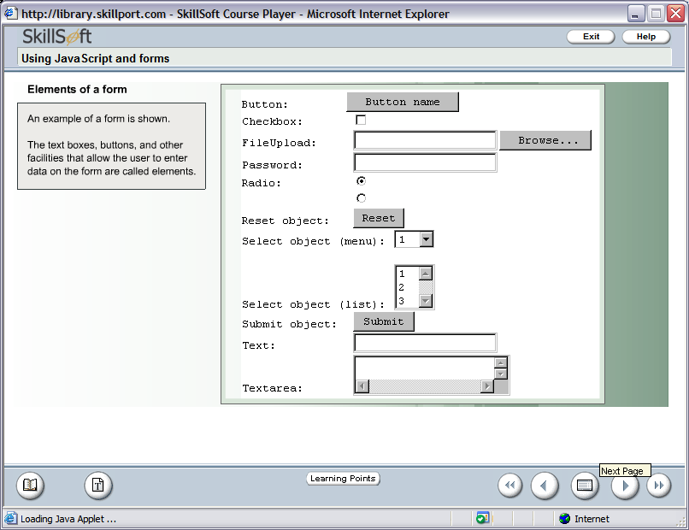
Form Object Model
An Example of Form is shown

Slide 91
Form Object Model (contd.)
In Java Script, an HTML form is represented by the form object.
Forms exist as elements of the Forms array. This array is a property of the document object.
The elements of the form like textbox, button etc. are stored as an forms object elements array property.

Slide 92
Form Object Model (contd.)
document.forms[0]
document.forms[0].elements[2]
document.f1 – Assuming f1 as the form name
This statement refers to the first form in your document.
This statement refers to the third element in the first form array
You can refer the form by its names also.
Notes:
To refer to the last form in the collection use document.forms[document.forms.length-1]

Slide 93
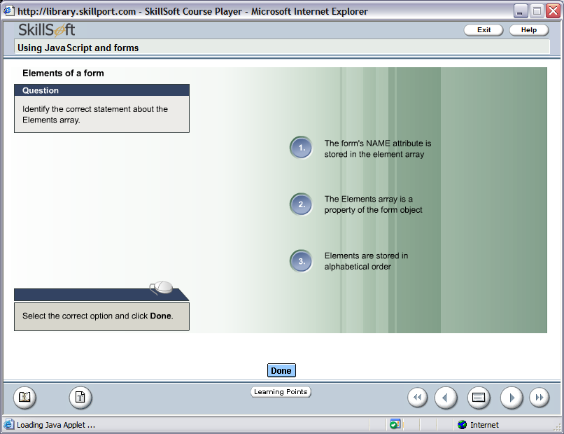
Test Your Understanding

Slide 94
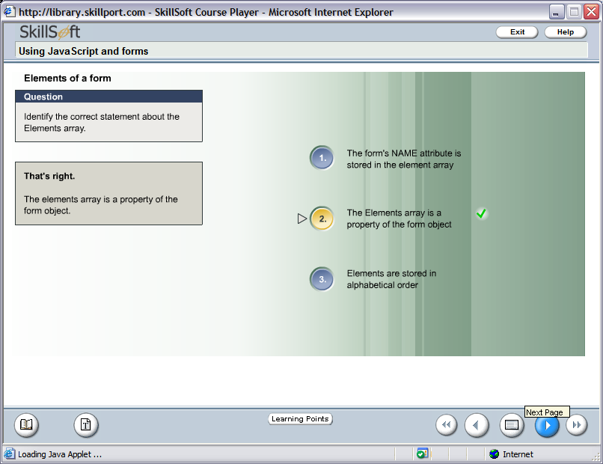
Test Your Understanding

Slide 95
Form Object Model (contd.)
The Form object has two methods:
  submit()
  reset()
  Example
  document.forms[0].submit()
  OR
  document.forms[0].reset()

Slide 96
Form Object Model (contd.)
Some of the properties of Form are as follows:
  action - specifies the server side script URL where the form will be submitted.
  method – specifies the method to be used to submit a form.
  target - It is used to load the result of the form submission in a target window.
  Example
  document.forms[0].action = “URL”
  document.forms[0].method = “Get”
  document.forms[0].target = “window.open(‘’,’FormWin’,’resizable=no,width=200,height=200’)”

Slide 97
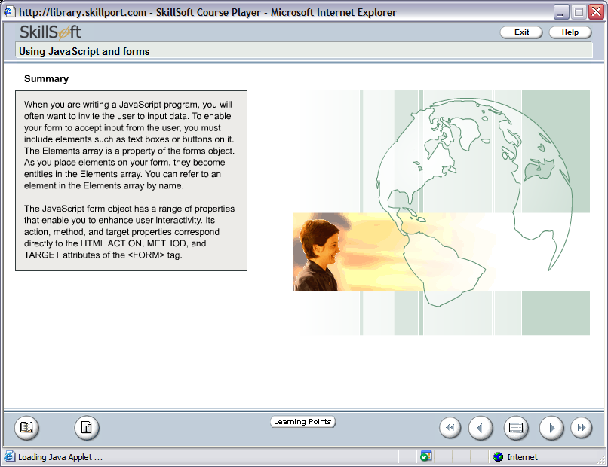

Slide 98
Cookies

Slide 99
Cookies
A cookie can store a small amount of information about a user visiting a site.
A cookie is a small text file that is stored on the site visitor's computer by their browser .
Because the cookie is stored on the user’s computer, it does not require any server space no matter how many users you have .
With JavaScript, you can both create and retrieve cookie values.
Notes:
Cookies were originally invented by Netscape to give 'memory' to web servers and browsers. The HTTP protocol, which arranges for the transfer of web pages to your browser and browser requests for pages to servers, is state-less, which means that once the server has sent a page to a browser requesting it, it doesn't remember a thing about it. So if you come to the same web page a second, third, hundredth or millionth time, the server once again considers it the very first time you ever came there.
This can be annoying in a number of ways. The server cannot remember if you identified yourself when you want to access protected pages, it cannot remember your user preferences, it cannot remember anything. As soon as personalization was invented, this became a major problem.
Cookies were invented to solve this problem. There are other ways to solve it, but cookies are easy to maintain and very versatile.

Slide 100
Cookies (contd.)
You can use cookies to :
  save user preferences.
  customize data.
  remember the last visit.
  Keep track of items in an order while a user browses.
  Remember the information your site’s visitors gave last time.
Cookies can be created, read and erased by JavaScript. They are accessible through the property document.cookie
Notes:
According to Netscape's official documentation, a client can hold up to 300 cookies. A cookie can be up to 4KB, including its name and value, which is exactly 4000 characters. A maximum of 20 cookies per server or domain are allowed.

Slide 101
Cookies (contd.)
What does a cookie contain?
  Name value pair
    The first element in a cookie is a "name" attribute, followed by the data to be stored in the cookie.
  The expiry date
    specifies how long the cookie is valid for.
Notes:
Cookies can be read by JavaScript too. They're mostly used for storing user preferences.
The first element in a cookie is a "name" attribute. Here, the "name" is a string used to identify the cookie (akin to a variable name), followed by the data to be stored in the cookie. This variable-value pair is required; you can't bake a cookie without it.

Slide 102
Cookies (contd.)
What does a cookie contain?
  The path
    this states where the cookie may be accessed from on the Web site. Most often, this is set to the server's document root.
  The domain
    The "domain" attribute allows you to set a domain name for the cookie. Again, this is optional.
Notes:
Each cookie also has a domain and a path. The domain tells the browser to which domain the cookie should be sent. If you don't specify it, it becomes the domain of the page that sets the cookie, in the case of this page www.quirksmode.org.
Please note that the purpose of the domain is to allow cookies to cross sub-domains. My cookie will not be read by search.quirksmode.org because its domain is www.quirksmode.org . When I set the domain to quirksmode.org, the search sub-domain may also read the cookie.
I cannot set the cookie domain to a domain I'm not in, I cannot make the domain www.microsoft.com . Only quirksmode.org is allowed, in this case.
The path gives you The path gives you the chance to specify a directory where the cookie is active. So if you want the cookie to be only sent to pages in the directory cgi-bin, set the path to /cgi-bin. Usually the path is set to /, which means the cookie is valid throughout the entire domain.
This script does so, so the cookies you can set on this page will be sent to any page in the www.quirksmode.org domain (though only this page has a script that searches for the cookies and does something with them).

Slide 103
Question
The name-value pair is the
_____________ element in the
Cookie
first
second
third

Slide 104
Answer
The name-value pair is the
_____________ element in the
Cookie
first
second
third

Slide 105
Cookies and Security
Turn up security level on your browser to disable cookies or prompt for cookie.
Delete the content of a cookie and then write protect it.
Use 3rd party software:
  Cookie Pal, CookieMaster, CookieCrusher to monitor, browse and edit cookies.
Notes:
With these 3rd party softwares you can decide which cookies you want to accept or reject and let Cookie Pal handle the rest - transparently and efficiently!

Slide 106
Format of Cookie
First the name value pair.
Then a semicolon and a space.
Then the expiry date.
  Expiry date should be in UTC format.
Then again a semicolon and a space.
Then the path.

Slide 107
Format of Cookie (contd.)
document.cookie=<name of cookie>=<value of cookie>;<blank space>expires=<date in UTC format>;<blank space>path=<path location>
Example
document.cookie = ‘user=Paul; expires=Thu, 2 Aug 2008 20:47:11 UTC; path=/'

Slide 108
Example of Setting a Cookie
<html>
<head>
<script language="JavaScript">
function setCookie(name, value) {
var exp=new Date("January 31,2008")
document.cookie=name+"="+escape
(value)+"; expires="+exp.toGMTString() +"; path=/test“
document.write(“Cookie has been set”)
)
</script>
</head>
<body>
<form>
<input type="button" value="Set a Cookie" onClick="setCookie(‘user',‘Paul Smith')">
</form>
</body>
</html>
What does the escape function do?
Set an expiry date

Slide 109
escape() function
There's no escape!
  Strictly speaking, we should be escaping our cookie values -- encoding non-alphanumeric characters such as spaces and semicolons.
  This is to ensure that our browser can interpret the values properly.
  Fortunately this is easy to do with JavaScript's escape() function.
  For example
  document.cookie = "username=" + escape(“Paul Smith") + "; expires=15/02/2003 00:00:00";

Slide 110
Example of Setting a Cookie
<html>
<head>
<script language="JavaScript">
function setCookie(name, value) {
var exp=new Date("January 31,2008")
document.cookie=name+"="+escape
(value)+"; expires="+exp.toGMTString() +"; path=/test“
document.write(“Cookie has been set”)
)
</script>
</head>
<body>
<form>
<input type="button" value="Set a Cookie" onClick="setCookie(‘user',‘Paul Smith')">
</form>
</body>
</html>
The value stored is
user=Paul Smith
Setting the cookie
Notes:
This is a very strict syntax, don't change it!

Slide 111
Reading a Cookie
<html>
<head>
<script language="JavaScript">
function readCookie() {
var ca = document.cookie
document.write(ca)
}
</script>
</head>
<body>
<form><input type="button" value="read" onClick="readCookie()">
</form>
</body>
</html>
Value retrieved is
user=Paul Smith
Returns the cookie
name value pair
Notes:
U can use the various String methods to extract the different parts of the cookie

Slide 112
Extracting only the value from the Cookie
<html>
<head>
<script language="JavaScript">
function readCookie(c_name)
{
if (document.cookie.length>0)
{c_start=document.cookie.indexOf(c_name + "=")
if (c_start!=-1)
{
c_start=c_start + c_name.length+1 c_end=document.cookie.indexOf(";",c_start)
if (c_end==-1) c_end=document.cookie.length
document.write( document.cookie.substring(c_start,c_end))
}
}
}
</script>
</head>
<body>
<form> <input type="button" value="read" onClick="readCookie('user')">
</form>
</body>
</html>
Displays the value:
Paul Smith
Notes:
This program checks for the cookie name “user” and uses the String functions to display the value

Slide 113
Delete Cookies
<html>
<head>
<script language="JavaScript">
function deleteCookie ( cookie_name)
{
var cookie_date = new Date ( )
cookie_date.setTime ( cookie_date.getTime() - 1 )
document.cookie = cookie_name += "=; expires=" + cookie_date.toGMTString()
}
</script>
</head>
<body>
<form>
<input type="button" value=“delete" onClick="deleteCookie(‘user')">
</form>
</body>
</html>
The cookie's expiry date is set
to one second less then the
current date.
Notes:
Refer to the cookie name created and reduce the expiry time period

Slide 114
Modifying a cookie
To modify a cookie simply reset the values and use the same procedure for setting the cookie.
Ensure that the cookie name is existing or a new cookie will be created.

Slide 115
Summary
Cookies are small text files that sit on your hard disk.
Cookies are created when you visit websites that use cookies to store information that they need (or prefer).
Websites often use cookies to personalize the user experience - such as remembering your name (assuming you supplied it previously) or remembering the items in your shopping cart from previous visits.
Despite the many misconceptions about cookies being malicious, they are quite harmless.
Cookies can't give your personal details to other websites, or transmit a virus or anything like that.
A cookie can only be read by the server that created it.
Websites normally use cookies to make its users' lives easier, not harder.

Slide 116
Thank You
For Your Participation

